Slide 1
Python Regular Expression

Slide 2
Learning Objectives
What is regular expression?
Usage of regular expression in Python for
matching
searching
substitution

Slide 3
History of the Term ‘Regular Expression’
The term regular expression comes from mathematics and computer science theory, where it reflects a trait of mathematical expressions called regularity. Such an expression can be implemented in software using a deterministic finite automaton (DFA).
The text patterns used by the earliest grep tools were regular expressions in the mathematical sense. Though the name has stuck, modern-day Perl-style regular expressions are not regular expressions at all in the mathematical sense. They’re implemented with a nondeterministic finite automaton (NFA).
All a practical programmer needs to remember from this note is that some ivory tower computer scientists get upset about their well-defined terminology being overloadedwith technology that’s far more useful in the real world.

Slide 4
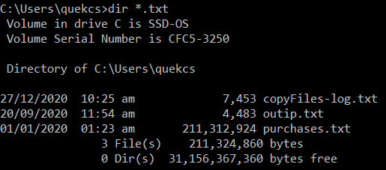
Regular Expression
Linux - The following example prints the matched line, along with the 3 lines after it.
$ grep -A 3 -i "example" demo_text

Slide 5
Password Validation
In CA1 you need to check whether the password is valid or not based on some conditions:
Should have at least one number.
Should have at least one uppercase and one lowercase character.
Should have at least one of these special symbols (!@#$%).
Should be between 4 to 20 characters long.
There is a better way – regex.
RegexPattern = r'^(?=.*[a-z])(?=.*[A-Z])(?=.*\d)(?=.*[!@#$%])[A-Za-z\d@$!#%*?&]{6,20}$'

Slide 6
r in regexPattern
import re
string = 'c:\filename'
regexPattern = 'c:\\filename' # need two \\ as \ is an esc char
result = re.search(regexPattern, string)
print(result)
import re
string = 'c:\filename'
regexPattern = r'c:\filename' # r prefix – raw string
result = re.search(regexPattern, string)
print(result)

Slide 7
Regular Expression
It is a powerful tools to enable you to find, extract and modify text that matches predefined patterns.
It is available in most of the programming languages (built-in or library based).
import re
email = 'mysite123@gmail.b'
regexPattern = r'^\w+([\.-]?\w+)*@\w+([\.]?\w+)*(\.\w{2,3})+$'
result = re.search(regexPattern, email)
print(result)
Notes:
Run script in Colab

Slide 8
Metacharacters
Regular Expressions are powerful
They are made up with metacharacters
“.” used to symbolize a single character
[xyz] used to symbolize matching of a single character with either x or y or z
\d used to symbolize a digit
[0-9] same as \d
[0-9]{0,3} used to symbolize matching of 0, 1 or up to 3 digit(s)
https://www.debuggex.com/cheatsheet/regex/python
Notes:
https://www.debuggex.com/cheatsheet/regex/python

Slide 9
Python regular expression primitive search functions - match
re.match(pattern, string)
Checks for a match only at the beginning of the string. Try to match the pattern from the string. The pattern can be a normal string or a regular expression (made up of meta-characters). Returns a match object on success, None on failure
import re
# Pattern: any 5 letter string at beginning of string, starting with a and ending with s. list1 = ['abs','2alias','abyss','Alias','A abacus']
regexPattern = r'^a...s$'
for word in list1:
result = re.match(regexPattern, word)
print(result)
Result:
None
None
<re.Match object; span=(0, 5), match='abyss'>
None
None

Slide 10
Python regular expression primitive search functions - search
re. search(pattern, string)
Checks for a match anywhere in the string. Try to match the pattern from the string. The pattern can be a normal string or a regular expression (made up of meta-characters). Returns a match object on success, None on failure
import re
# Pattern: any 5 letter string, starting with a and ending with s.
list1 = ['abs','2alias','abyss','Alias','A abacus']
regexPattern = r'a...s$'
for word in list1:
result = re.search(regexPattern, word)
print(result)
Result:
None
<re.Match object; span=(1, 6), match='alias'>
<re.Match object; span=(0, 5), match='abyss'>
None
None

Slide 11
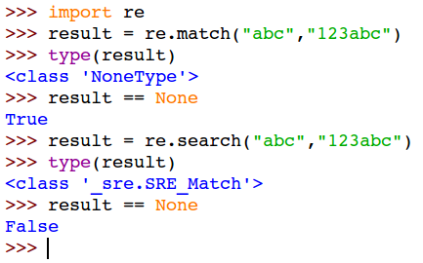
Python regex basic find functions
re.match(pattern, string) – at beginning of string
re.search(pattern, string) – anywhere
Match/search for the pattern of "abc" (no regex involves) from string.

Slide 12
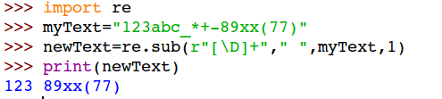
Python regex basic find and replace function
re.sub(pattern,repl,string,count=0,flags=0)
Example 1:
Replacing the first occurrence of a sequence of non-digit characters with a single ' '.
[\D]+ → denotes a sequence of one or more non-digits
r"" → insert a leading 'r' to denote a 'raw string literal'.
The optional argument count is the maximum number of pattern occurrences to be replaced; count must be a non-negative integer. If omitted or zero, all occurrences will be replaced.
flags (optional argument): a more advanced modifier that allows you to customize the behavior of the method. Per default, you don’t use any flags.
Notes:
import re
myText = '123abc-*+-89xx(77)'
newText = re.sub(r'[\D]+',' ', myText,1)
print(newText)

Slide 13
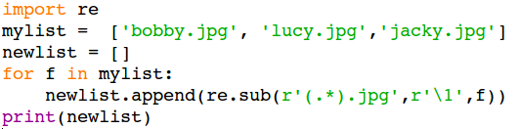
'Repl' can also be a regex pattern
Example 2:
Truncate the .jpg suffix from a list of jpeg filenames.

Slide 14
Use cases of regular expressions
Information Extraction
Search and pickup specific entries from a network traffic log file.
Counting the total number of 404 (page not found)
Massive text formatting and cleansing
Input validation, for instance
Before converting a binary number into decimal, you may want to first check if the input string contains only 0s or 1s.
See from the next few slides

Slide 15
To validate a binary value input
Without Regular Expression
This is the conventional approach
Require character by character checking within a iteration block.
def checkbin(b):
for ch in b:
# if ch != '1' and ch != '0':
if not (ch == '0' or ch == '1'):
return False
return True
bstr = '1100'
if checkbin(bstr):
print(f'It is equivalent to {int(bstr,2)}')
else:
print('Oops!')
Notes:
if not (ch == '0' or ch == '1'):

Slide 16
To validate a binary value input
With Regular Expression, re module match function
Using a regular expression 'pattern' to check against a given 'text'
import re
bstr = '1100'
if (re.match(r'[01]+$', bstr)):
print(f'It is equivalent to {int(bstr,2)}')
re.match(search_pattern, target_string)
search pattern = r'^[01]+$'
This bizarre looking pattern is in fact a "regular expression"
r --> denotes the follow string is a regex pattern
match() starts at the beginning of the target string
'[01]+$' --> A pair of quotes encloses the pattern
[01] --> Matching with one character, it can be either a '0' or '1'
[01]+ --> The '+' denotes 1 or more repeating matches
$ --> The '$' denotes the end of the target string. d

Slide 17
Practice
Work through the examples in the link below.
https://www.programiz.com/python-programming/regex#python-regex
import re
# The pattern is: any five letter string starting with a and ending with s.
list1 = ['abs','alias','abyss','Alias','A abacus']
regexPattern = r'^a...s$'
for word in list1:
result = re.findall(regexPattern, word)
print(result)
Result:
[]
['alias']
['abyss']
[]
[]
Notes:
We shall discuss some items if you have any questions.

